Slide 1
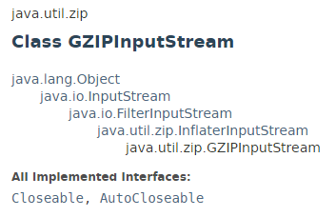
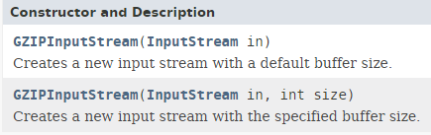
GZIPInputStream - How to decompress file from GZIP file

Slide 2
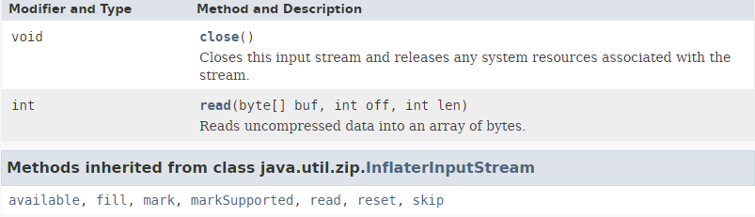
GZIPInputStream - How to decompress file from GZIP file

Slide 3
GZIPInputStream - How to decompress file from GZIP file
https://docs.oracle.com/javase/8/docs/api/index.html?java/util/zip/GZIPInputStream.html

